Slide 1

DriverPass System Analysis
Tashi Anderson
Notes:
[No speaker notes required for this slide.]

Slide 2

System Requirements
Functional requirements:
Customers can select desired packages to partake in
Customers can schedule and book driving lessons
Nonfunctional requirements:
Maintainable
Secure
Notes:
DriverPass has a few requirements that needs to be addressed. Some functional requirements are to allow the customer to select packages to partake in. This means that learning drivers have the option to choose the package that best suit their learning needs as well as pricing needs. Another requirement is to let customers schedule and book driving lessons. This allows for the customer to fully take control of their schedule, whether or not they may need more in person driving lessons or less.
Non-functional requirements would have to include maintenance and security. These requirements are integral to the safety of the DriverPass users, where we take security seriously.

Slide 3
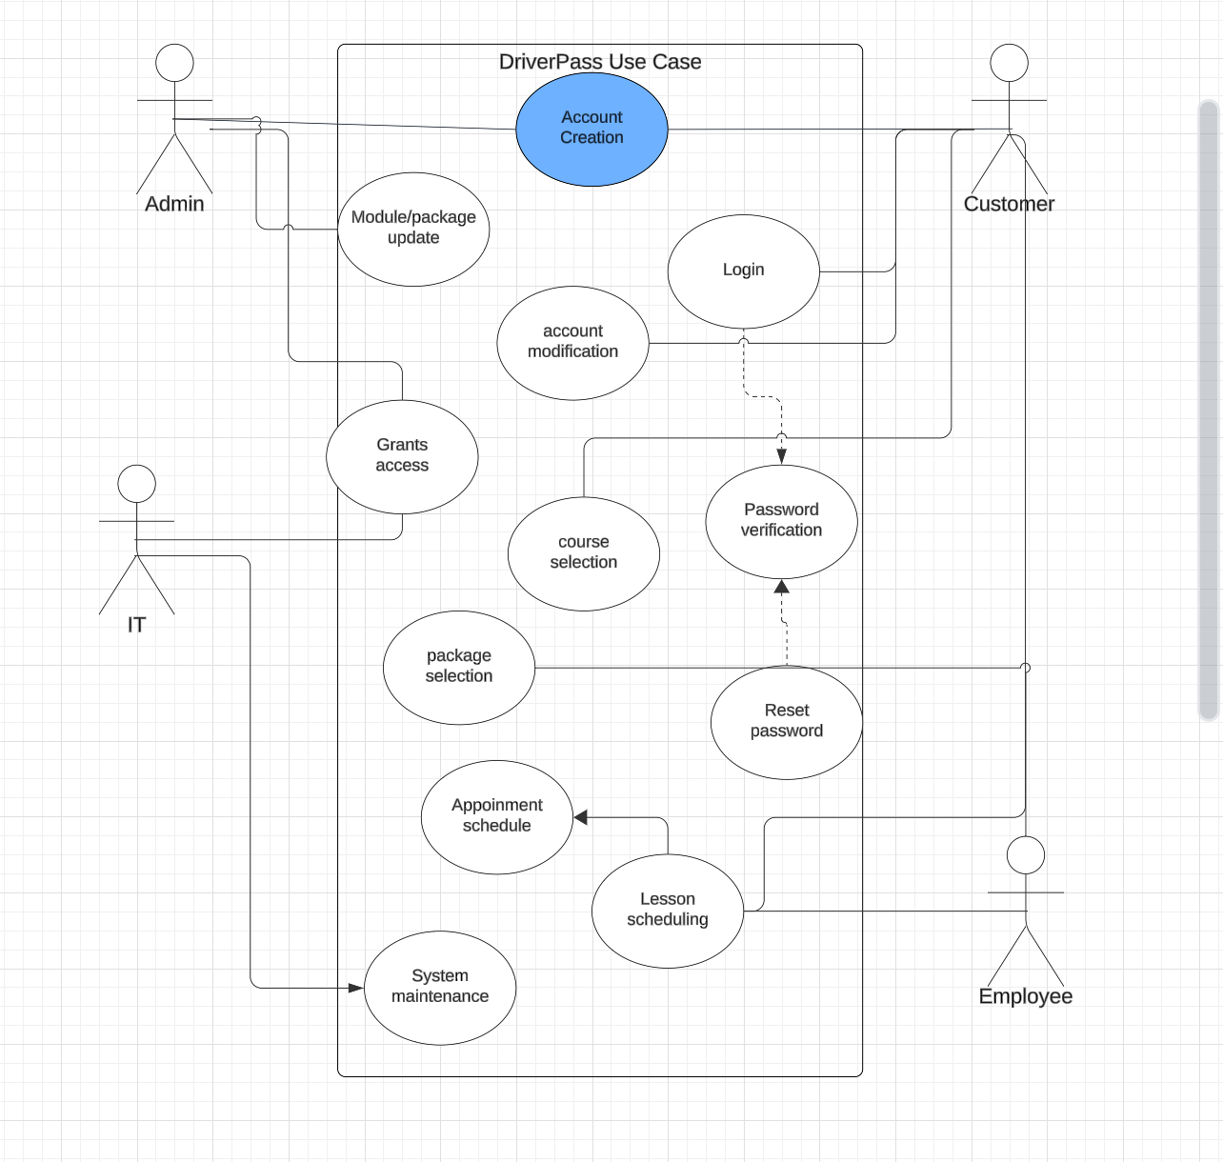
Use Case Diagram
Notes:
This diagram shows four different users of this system, which are the admin, IT users, the customer, and the employee. All users can create their own account, set their information, and set their passwords.
Though, some users have unique abilities, such as the employee. Employees can schedule the customers lessons as well as appointments, while an admin can modify available packages that are offered through the DriverPass system. To account for the various needs of the DriverPass system, I had to look through the various point of views of the four users. This really allowed me to understand what a certain user would need to have available to them in order to make their user experience as smooth as possible.

Slide 4
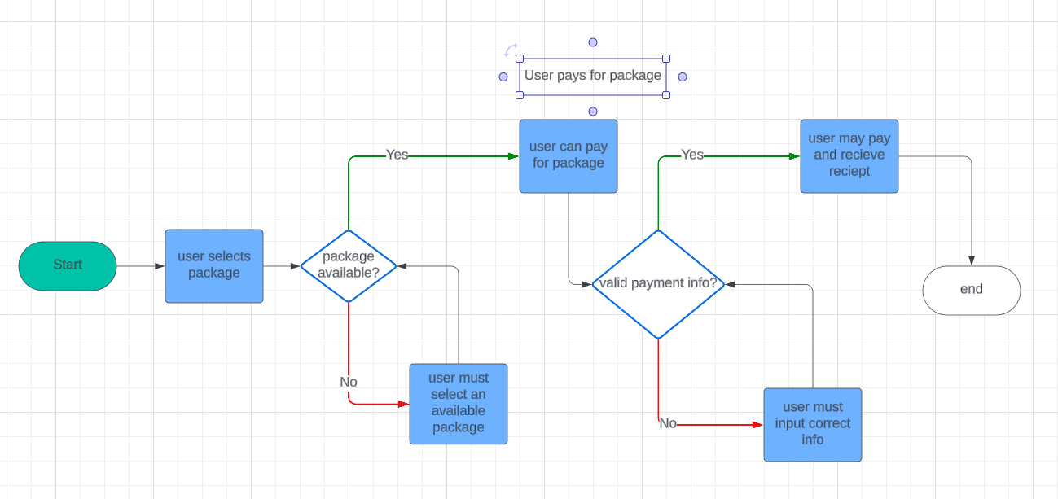
Activity Diagram
Notes:
This diagram shows how a customer might pay for a package available through the DriverPass system. First, the customer must select and available package, then input valid payment information, and finally they can pay and receive a receipt. There are areas where the diagram asks a yes or no question, which the system will do a sort of internal check, ensuring that the customer is selecting the right information and inputting the correct information. I have these yes or no questions to make the user experience as smooth as possible.

Slide 5
Security
2fA
Case-sensitive
PassKey
Notes:
Security is a big concern for DriverPass, but we have implemented many ways for the users to keep their information safe. 2 factor authentication, or simply 2fa for short, allows for the users to connect their phone number or email to their account to receive a pin. This pin allows for them to log in to their account and can prevent any malicious brute force hacking from taking place.
Users must abide by certain password rules, such as having a case-sensitive password that must include a number and some sort of special character. This rule also prevents from brute force hacking.
PassKeys can also be set up, where a user may use their faceID (in iPhones) to quickly log in to their account. This PassKey further prevents hacking, as a user account is directly linked to the user’s face.

Slide 6
System Limitations
Hardware availability
Time
Money
Notes:
Some limitations for DriverPass is the available hardware, time, and money. These are issues that every project faces but are big roadblocks that can be faced when developing DriverPass. DriverPass will be available on a multitude of operating systems and cell phones, which means that we must test on these devices. This means we must hire testers that have one or more of these platforms available to them, which in turn may drive up the cost of this project. Time also plays into this issue, as it would take a lot of time to iron out issues on multiple platforms.

